Slide 1

Charging Ahead - Predicting Optimal Charging Station Locations across Multiple Cities
Urban Big Data Thesis Award 2017
Jonathan von Rueden

Slide 2
Research Question and Results
Question 1
Question 2
Can point of interest information can be used to predict profitable EV charging locations in mid-sized to large cities?
Are such predictive models
valid across multiple cities?
How can point of interest information be used
to improve decision making in charging station
placement?
Results:
Both questions answered in the affirmative
Model outperforms any naive model by 24.1% in targeted accuracy
Savings of up to 11% in fixed cost investment per city for station operators
1

Slide 3

Literature and Motivation
Chicken-egg problem of EV charging and car sharing
Key research:
Chicken-egg dilemma by Gnann et al. (2015)
Random Forest to predict wildfires by Oliveira et al. (2012)
Willingness-to-walk by Untermann et al. (2014)
Significant influence of PoIs for charging demand by Xi et al. (2013)
Points of interest often mentioned as strong parking charging demand influencers
Random Forests used in spatial prediction problems
02

Slide 4
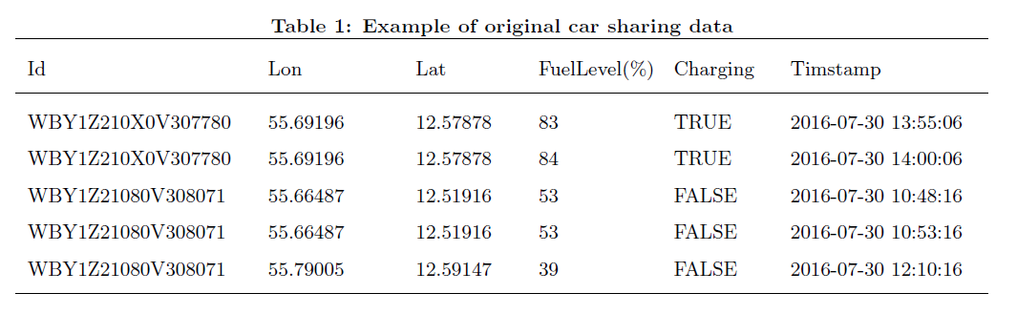
Data
03

Slide 5
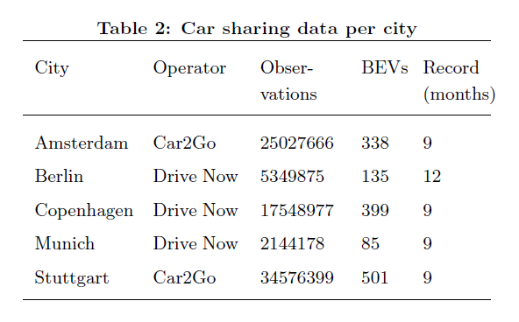
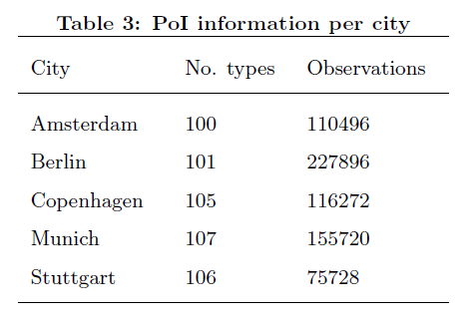
Data
04

Slide 6



Methodology
Parking instances
Hexagonal grid
Aggregation
Prediction
$$\sum_{k=0}^{n}{p_{i, k}}$$
$$\sum_{k=0}^{n}{p_{i, k}}$$
05

Slide 7
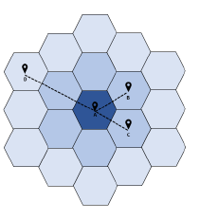
Data Preparation
Potential charging demand aggregation
06

Slide 8
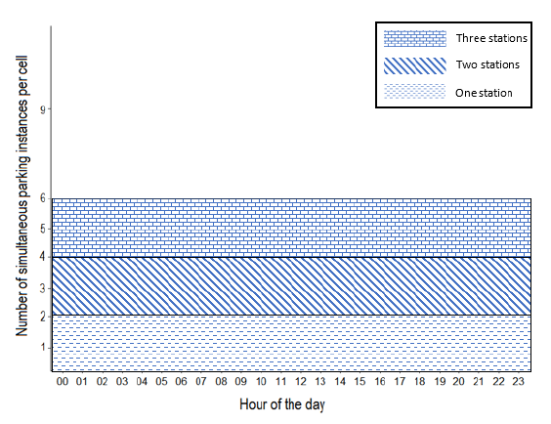
Data Preparation
Optimal, uniform cell occupation distribution
07

Slide 9
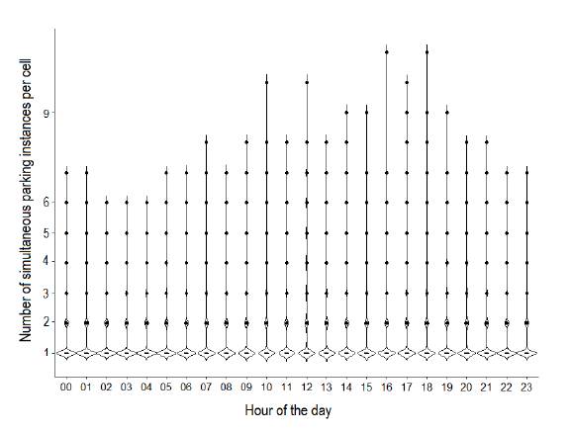
Data Preparation
Actual cell occupation for cells with in top 10% of charging demand
08

Slide 10
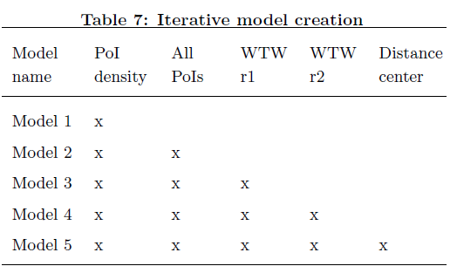
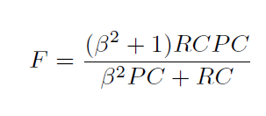
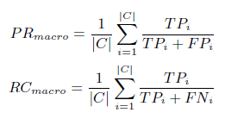
Modeling
09

Slide 11
Model Performance
Macro F-measure for model 1 to 5
23%
39%
45%
46%
50%
Model 1
Model 2
Model 3
Model 4
Model 5
10

Slide 12
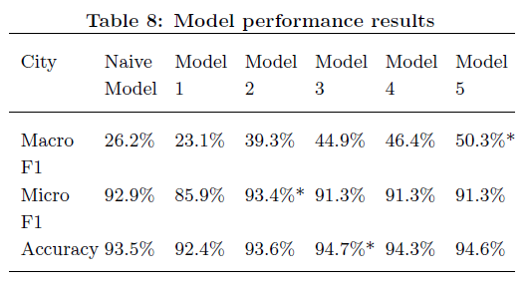
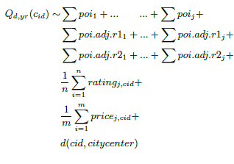
Results in Detail
301
features
11

Slide 13
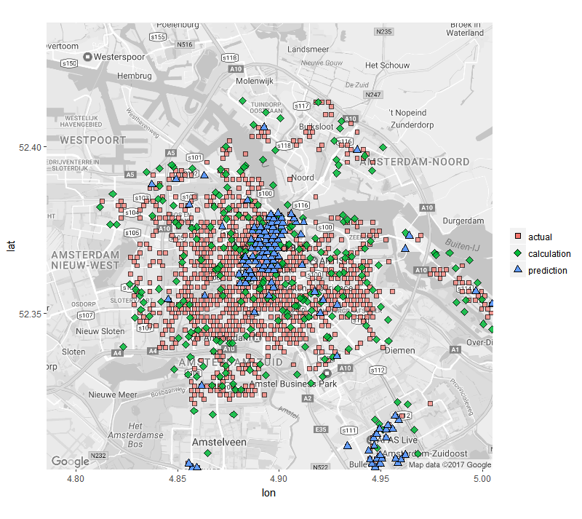
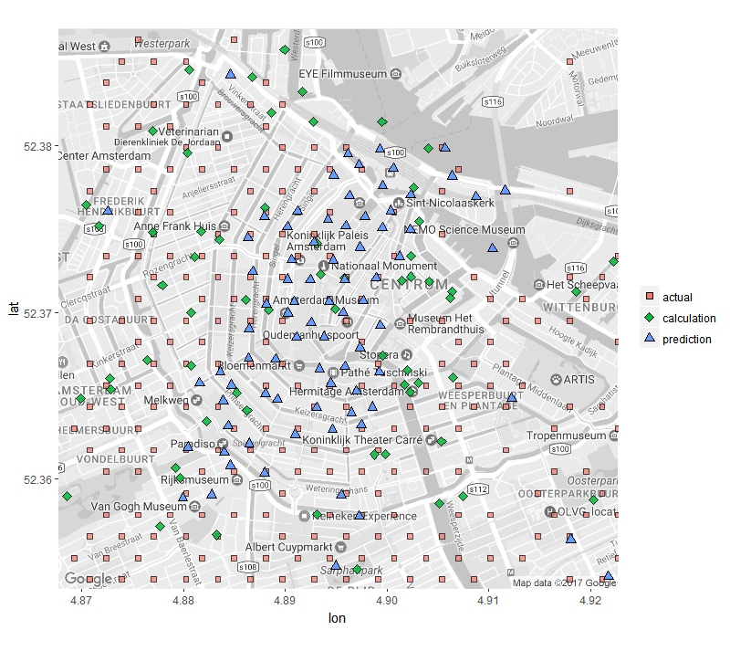
Predictive Results
Model applied to the city of Amsterdam
12

Slide 14
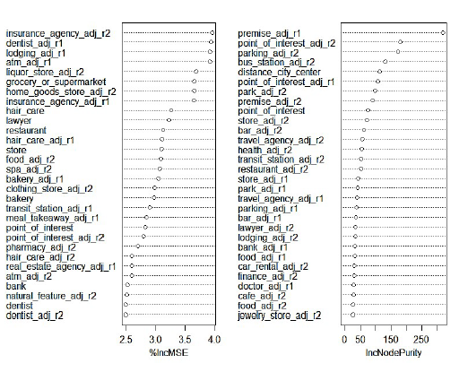
Predictive Results
Model applied to the city of Amsterdam
13

Slide 15
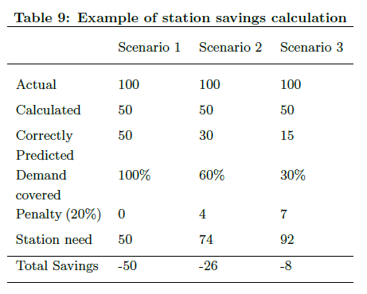
Predictive Results
Potential savings from using the model in business
Details for the 5 target cities:
up to 11% in fixed cost investment per city.
hypothetical savings for operators amounted to:
  82,000 Euros in Amsterdam
  16,000 Euros in Copenhagen
  53,000 Euros in Berlin
  20,000 Euros in Stuttgart
  11,000 Euros in Munich
  In fixed cost savings per year
14

Slide 16
Implications
Decision support
Cost saving
Apply anywhere
Collect more data
Future research
Can the chicken-egg dilemma be solved?
15

Slide 17



Future Research
Private EV parking patterns
Volume and variety of data
Neural nets
Involve charging station operators
16

