Slide 1
The effect of data quality and metadata on data-driven decision making
Urban Big Data Thesis Award
Josephine Peeters
November 23, 2017

Slide 2
Introduction
Master Business Information Management
Internship Enterprise Data Management
Data is growing
Companies want to become more data-driven
Poor data quality has negative consequences
Metadata plays important role in determining data quality

Slide 3
Research question
What is the effect of data quality and metadata on data-driven decision making?
Approach: 2 case studies
Process from business question to decision
Notes:
Case studies: contemporary phenomenon within a real-life context
Highlight case study about Amsterdam Arena because of urban theme

Slide 4
Case study: Amsterdam ArenA
Event venue
Operational Mobility Centre (OMC)
Notes:
Introduction to company
OMC: municipality, police, parking lot owners, NS

Slide 5
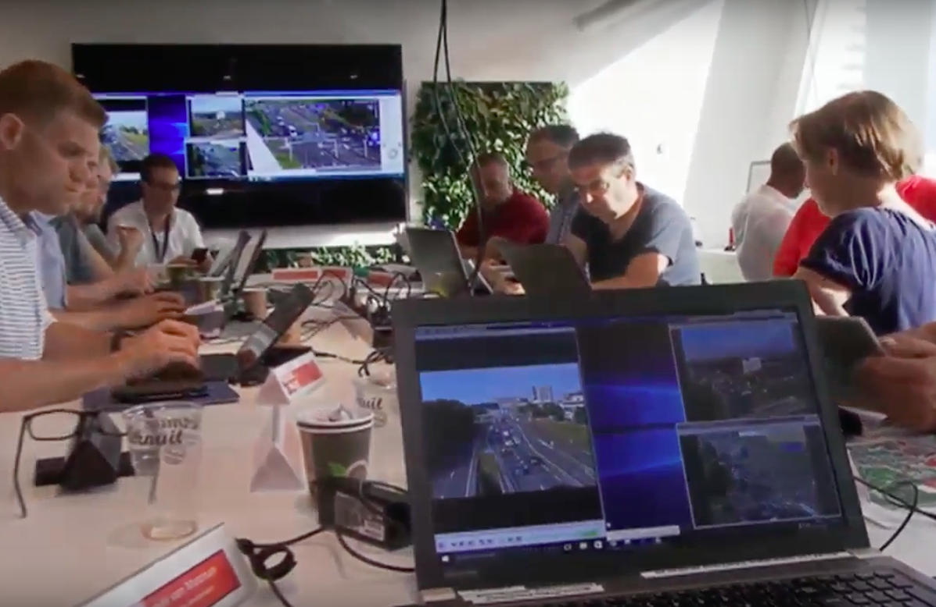
Case study: Amsterdam ArenA
Business questions:
Distribution of ways of transport
Distribution of parking lots
Notes:
Business questions in order to make right decisions based on data
Estimation of modal split based on experience of past events
Live camera images

Slide 6
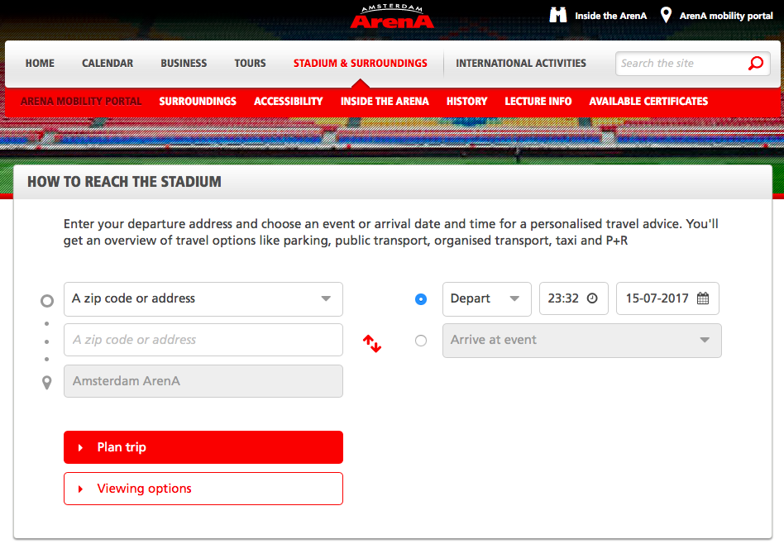
Case study: Amsterdam ArenA
Mobility portal
Notes:
https://www.youtube.com/watch?v=YVrG5MC5wRc

Slide 7
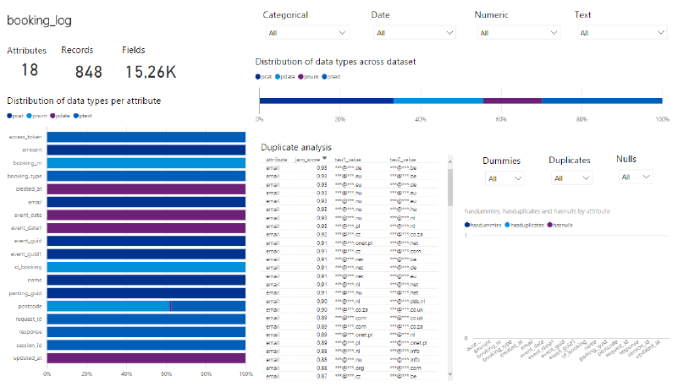
Case study: Amsterdam ArenA
Data profiling
Notes:
Mobility portal data about Armin Only event:
booking_log: tickets parking lots
frontend_log: ways of transport
externalurl_log: clicks to third parties selling parking lot tickets
webservice_log: clicks on mobility portal

Slide 8
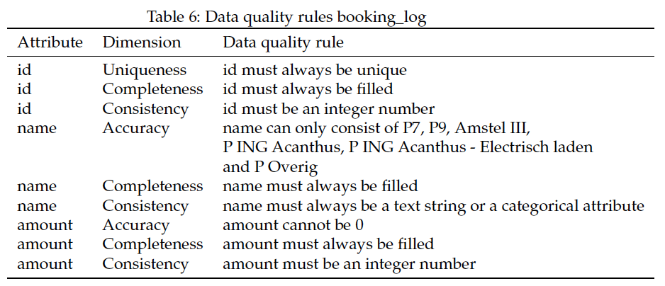
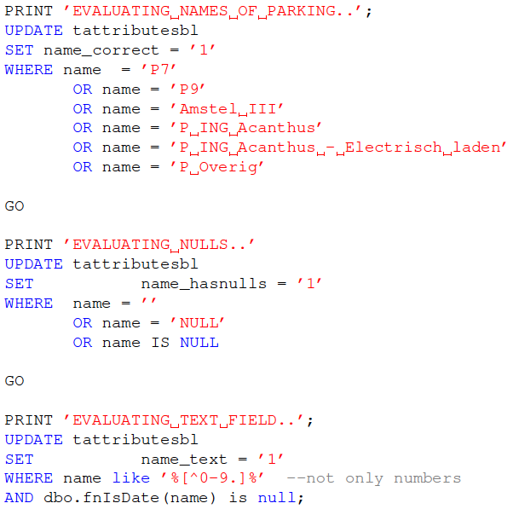
Case study: Amsterdam ArenA
Data quality measuring
Notes:
Critical attributes
SQL queries
Data quality dimensions

Slide 9
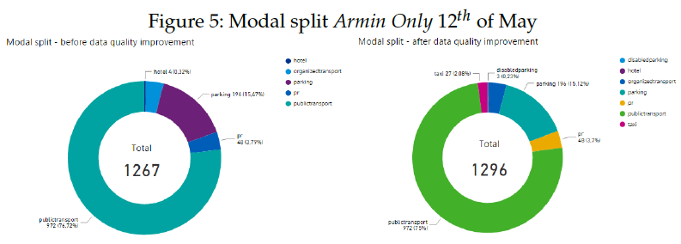
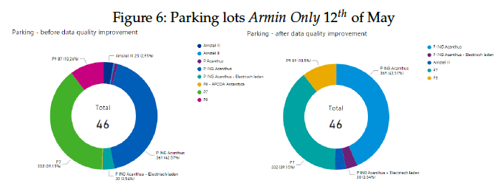
Case study: Amsterdam ArenA
Data integration, data analytics, data visualization
Notes:
More ways of transport are visible and mapped to more records
Right names of parking lots in dashboard

Slide 10
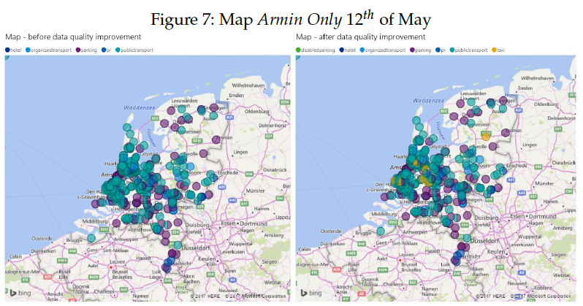
Case study: Amsterdam ArenA
Data integration, data analytics, data visualization
Notes:
More ways of transport

Slide 11
Case study: Amsterdam ArenA
Evaluation to business questions:
Mobility portal small proportion of real number of visitors
Representativeness cannot be determined
Decisions cannot be made about:
Additional trains/metros
Leading cars to parking lots that are not yet full
Recommendation to ArenA:
Gather additional data
Notes:
Evaluation to business question: distribution ways of transport, distribution parking lots
Data-driven decision making
Recommendation to ArenA: Gather additional data about the real distribution of ways of transport and the real distribution of parking lots in order to check the representativeness of the mobility data

Slide 12
Conclusion
Case study: Amsterdam ArenA
Data analytics results better after improving data quality
Available data still not sufficient for decision making
Case study 2
Confirmed findings in case study Amsterdam ArenA
Conclusion
Data quality and metadata have a positive effect on data-driven decision making

Slide 13
Q&A

